Slide 1
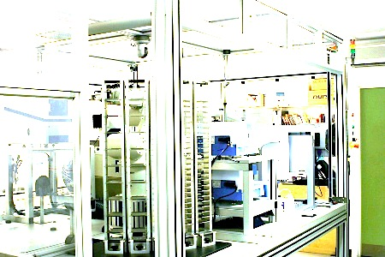
The Automation of Science
Ross D. King,
University of Manchester & AIST, ross.king@manchester.ac.uk

Slide 2
Scientific Discovery

Slide 3
Technology Drivers
Improved computer hardware:
faster processors, more processors, GPUs, …
Improved data availability:
computers recording almost everything, deep data, …
Improved computer software:
new machine learning methods, deep mining, …

Slide 4
Artificial Intelligence (AI)
There have been multiple AI hype cycles, but this time it seems different.
AI, especially machine learning, is now the hottest technology on the planet. Speed of Advance has surprised me.
Machine Learning is the core technology of Google, Facebook, Amazon, …Tencent, Alibaba, Baidu, …

Slide 5
AI Systems have Superhuman Scientific Reasoning Powers
Flawlessly remember vast numbers of facts
Execute flawless logical reasoning
Execute optimal probabilistic reasoning,
Learn more rationally than humans
Learn from vast amounts of data
Extract information from millions of scientific papers.
Etc.

Slide 6
Scientific Discovery
Scientific problems are abstract, but involve the real-world.
Scientific problems are restricted in scope – no need to know about “Cabbages and Kings”.
Nature is honest – no malicious agents.
Nature is a worthy object of our study.
The generation of scientific knowledge is a public good.

Slide 7
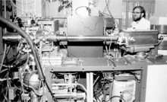
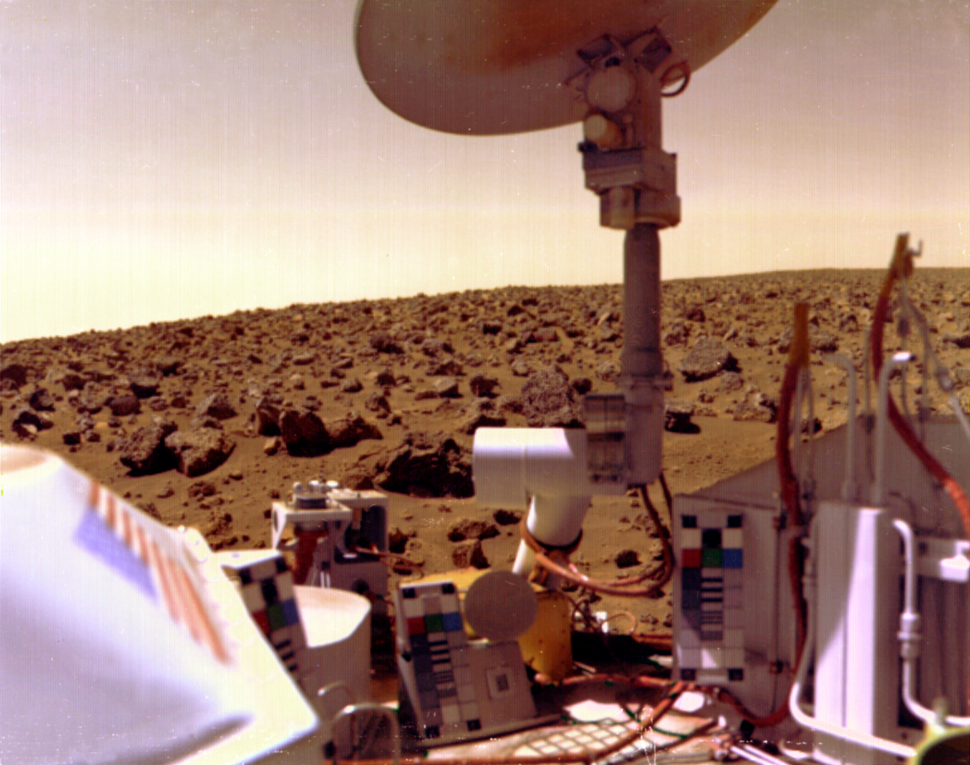
Meta-Dendral
Analysis of mass-spectrometry data.
Joshua Lederburg, Ed. Feigenbaum, Bruce Buchanan, Karl Djerassi, et al. 1960-70s.

Slide 8
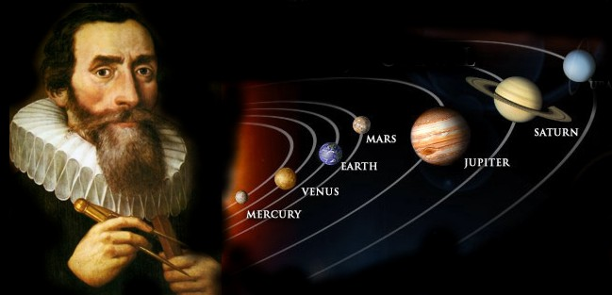
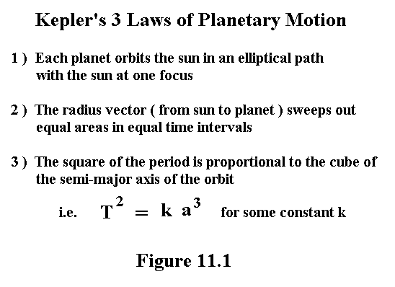
Bacon
Rediscovering physics and chemistry: Langley, Bradshaw, Simon (1979).

Slide 9
Robot Scientists

Slide 10
The Concept of a Robot Scientist
Computer systems capable of originating their own experiments, physically executing them, interpreting the results, and then repeating the cycle.
Background Knowledge
Analysis
Hypothesis Formation
Results Interpretation
Final Theory
Experiment selection
Robot

Slide 11
Motivation: Philosophical
What is Science?
The question whether it is possible to automate scientific discovery seems to me central to understanding science.
There is a strong philosophical position which holds that we do not fully understand a phenomenon unless we can make a machine which reproduces it.

Slide 12
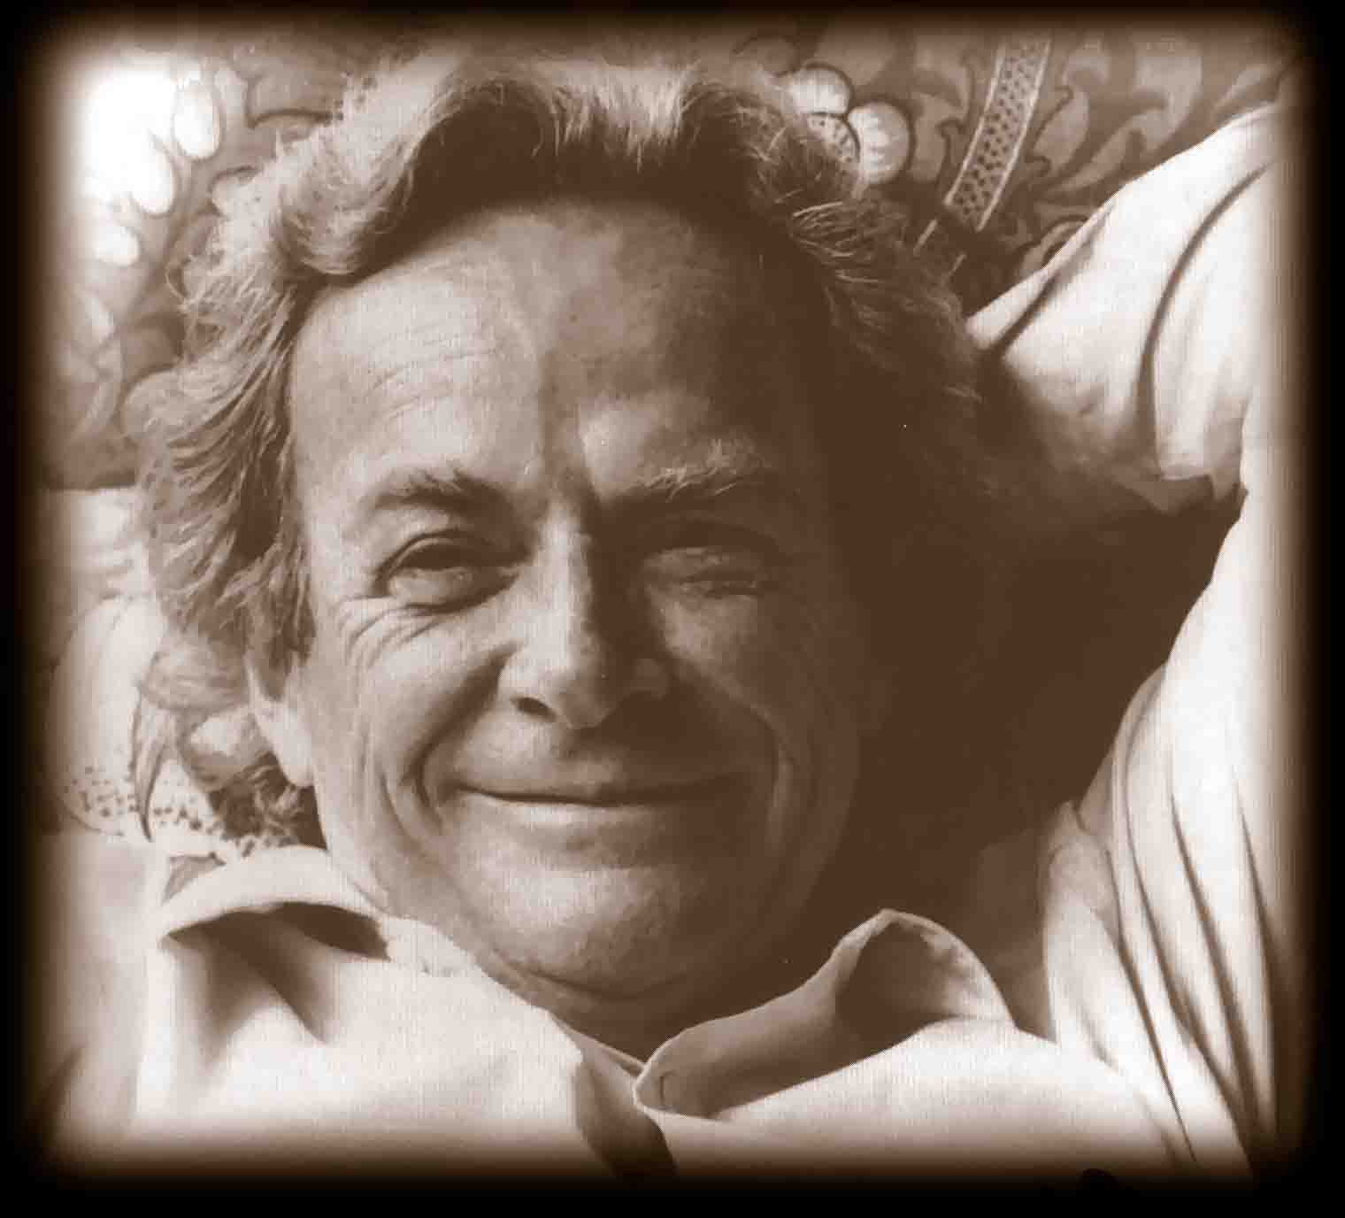
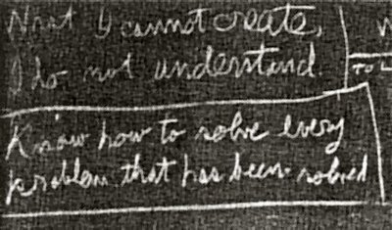
Richard Feynman’s Blackboard
“What I cannot create, I do not understand”

Slide 13
Motivation: Technological
Robot Scientists have the potential to increase the productivity of science. They can work cheaper, faster, more accurately, and longer than humans. They can also be easily multiplied.
Enabling the high-throughput testing of hypotheses.
Robot Scientists have the potential to improve the quality of science.
by enabling the description of experiments in greater detail and semantic clarity.

Slide 14
Robot Scientist Timeline
1999-2004 Initial Robot Scientist Project
Limited Hardware: Collaboration with Douglas Kell (Aber Biology), Steve Oliver (Manchester), Stephen Muggleton (Imperial)
King et al. (2004) Nature, 427, 247-252
2004-2011 Adam – Yeast Functional Genomics
Sophisticated Laboratory Automation: Collaboration with Steve Oliver (Cambridge).
King et al. (2009) Science, 324, 85-89
2008-2015 Eve – Drug Design for Tropical Diseases
Sophisticated Laboratory Automation: Collaboration with Steve Oliver (Cambridge)
Williams et al. (2015) Royal Society Interface, DOI 10.1098/rsif.2014.1289
2015-2018 Eve – Human cells - Cancer, Yeast - Aging
DARPA, CHIST-ERA

Slide 15
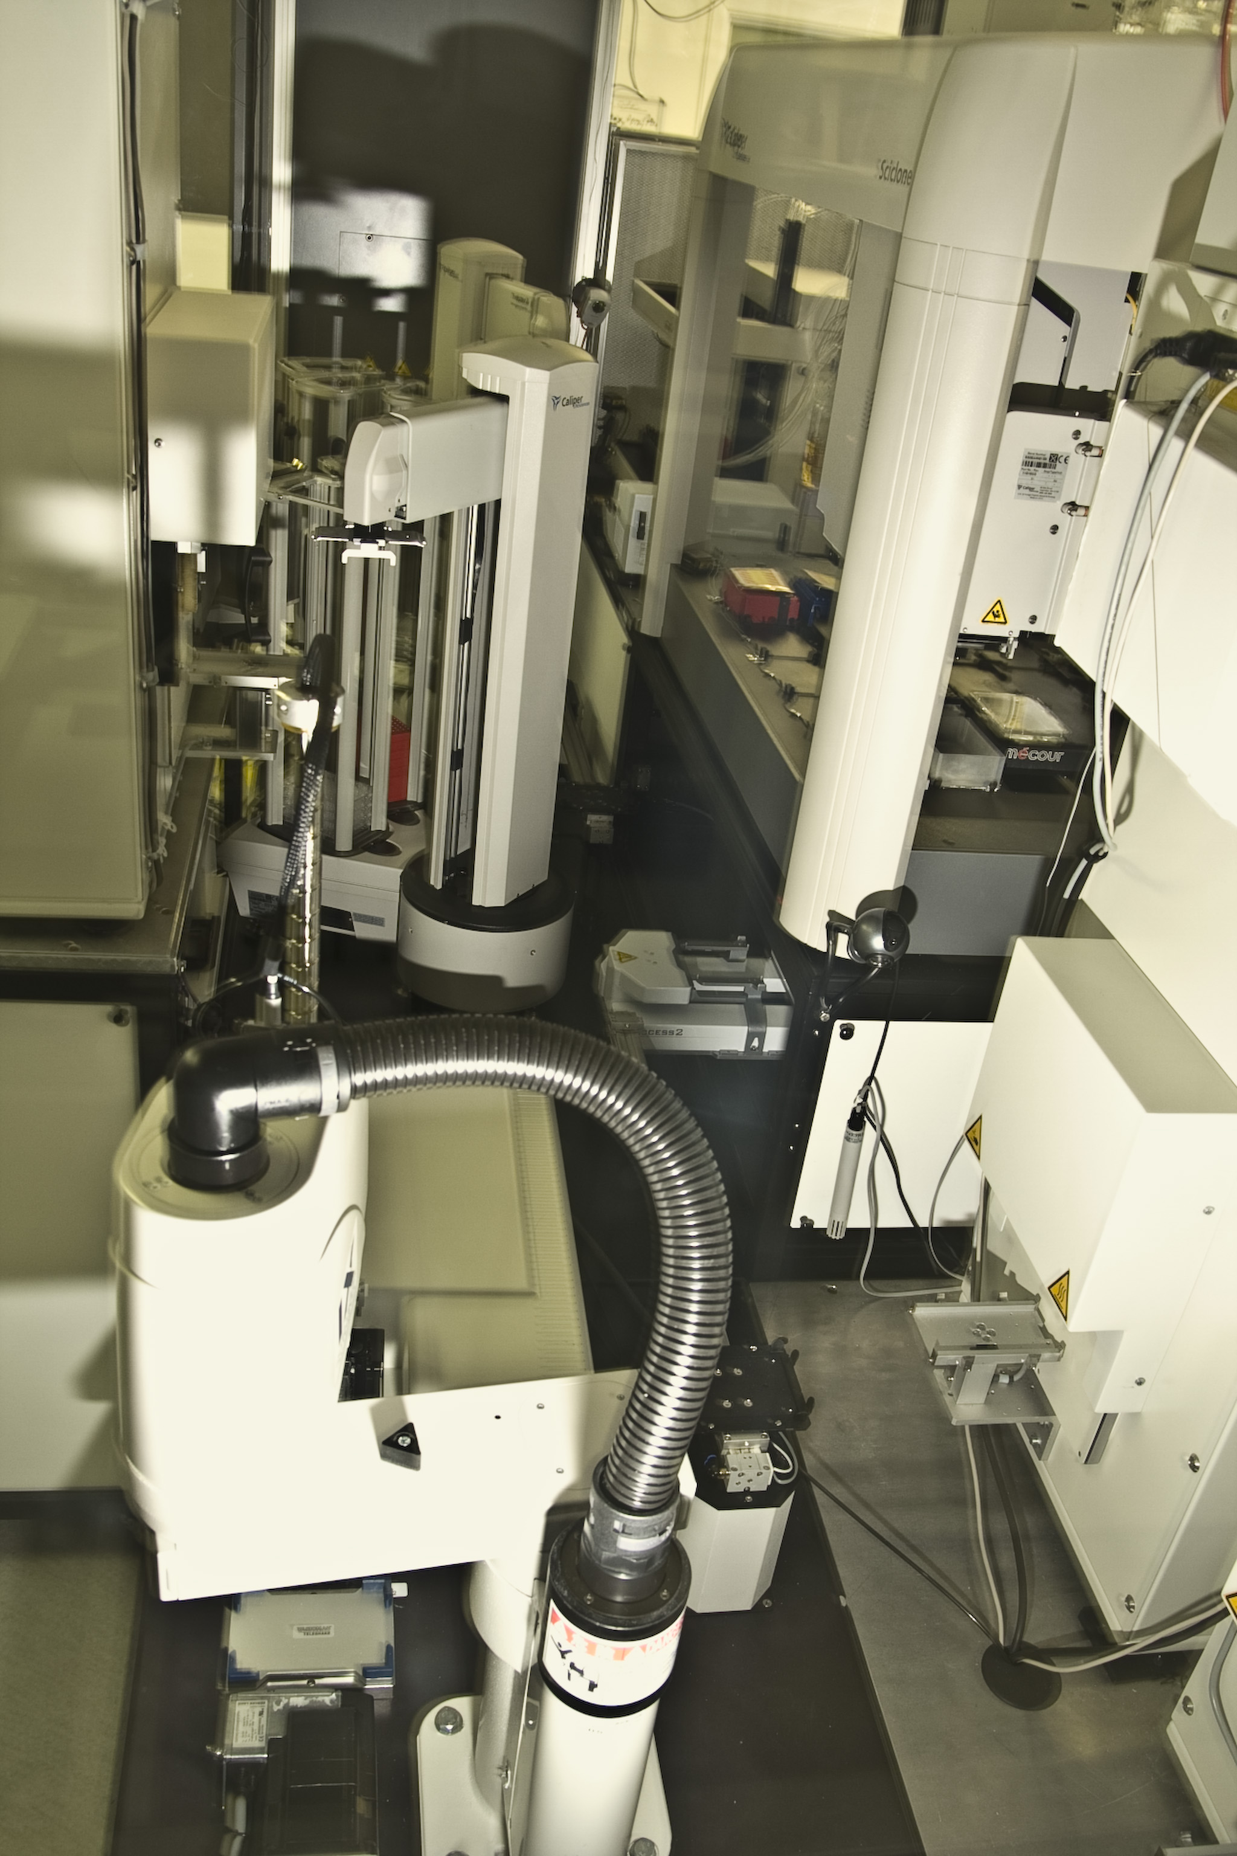
Adam

Slide 16
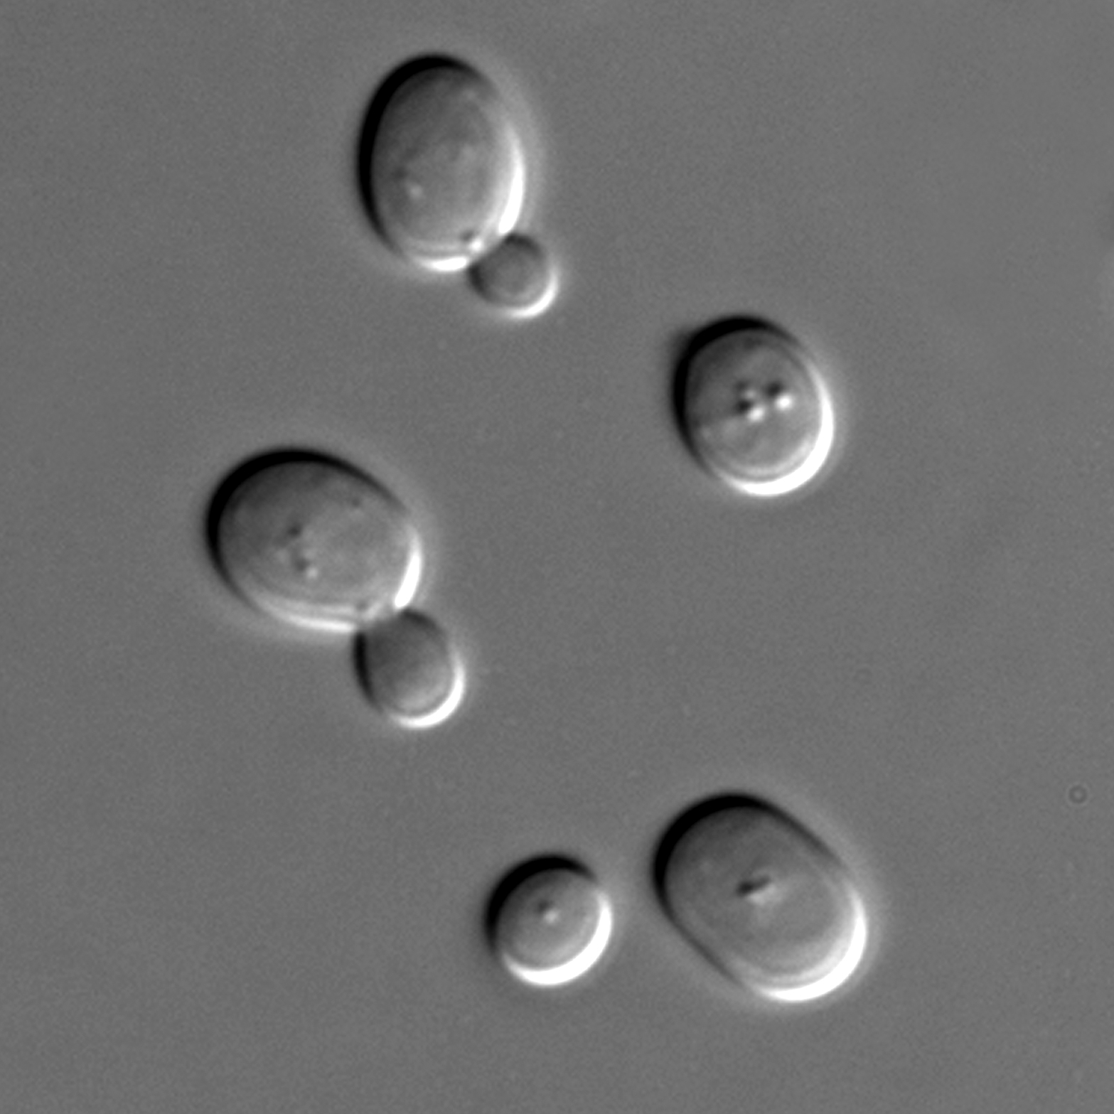
The Application Domain
Functional genomics
In yeast (S. cerevisiae) ~15% of the 6,000 genes still have no known function.
EUROFAN 2 made all viable single deletant strains.
Task to determine the “function” of a gene by growth experiments.

Slide 17
Formalising the Problem
Use logic programming to represent background knowledge: metabolism modelled as a directed labeled hyper-graph.
Use abduction to infer new hypotheses:
Abductive logic programming.
Techniques from Bioinformatics.
Use active learning to decide efficient experiments: cost of compounds and time.
Use machine learning to decide meaning of experimental results.

Slide 18
Types of Logical Inference
Deduction
Rule: All swans are white.
Fact: Daffy is a swan.
∴ Daffy is white.
Abduction
Rule: All swans are white.
Fact: Daffy is white.
∴ Daffy is a swan.
Induction
Fact: Daffy is a swan and white.
Fact: Tweety is a swan and white
∴ All swans are white.

Slide 19
Types of Logical Inference
Deduction
Rule: All swans are white.
Fact: Daffy is a swan.
∴ Daffy is white.
Abduction
Rule: All swans are white.
Fact: Daffy is white.
∴ Daffy is a swan. Daffy is a duck.
Induction
Fact: Daffy is a swan and white.
Fact: Tweety is a swan and white
∴ All swans are white.

Slide 20
Types of Logical Inference
Deduction
Rule: All swans are white.
Fact: Daffy is a swan.
∴ Daffy is white.
Abduction
Rule: All swans are white.
Fact: Daffy is white.
∴ Daffy is a swan.
Induction
Fact: Daffy is a swan and white.
Fact: Tweety is a swan and white
∴ All swans are white.

Slide 21
Types of Logical Inference
Deduction
Rule: All swans are white.
Fact: Daffy is a swan.
∴ Daffy is white.
Abduction
Rule: All swans are white.
Fact: Daffy is white.
∴ Daffy is a swan.
Induction
Fact: Daffy is a swan and white.
Fact: Tweety is a swan and white
∴ All swans are white.
Bruce is a black swan.

Slide 22
Novel Science
Adam generated and confirmed novel functional-genomics hypotheses concerning the identify of genes encoding enzymes catalysing orphan reactions in the metabolic network of the yeast S. cerevisiae.
Adam's conclusions have been manually verified using bioinformatic and biochemical evidence.
Adam was the first machine to autonomously discover novel scientific knowledge: hypothesise, and experimentally confirm.

Slide 23
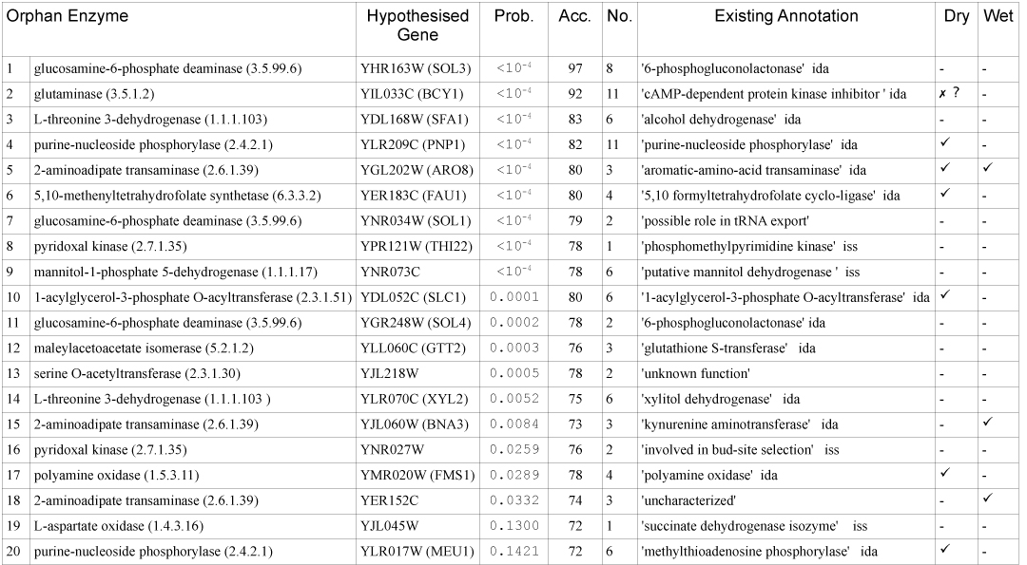
Novel Scientific Knowledge

Slide 24
Formalising Science

Slide 25
Formalisation of Science
The goal of science is to increase our knowledge of the natural world through the performance of experiments.
This knowledge should be expressed in formal logical languages.
Formal languages promote semantic clarity, which in turn supports the free exchange of scientific knowledge and simplifies scientific reasoning.

Slide 26
Robot Scientist & Formalisation
Robot Scientists provide excellent test-beds for the development of methodologies for formalising science.
Using them it is possible to completely capture and digitally curate all aspects of the scientific process.
The ontology LABORS is designed to enable the open access of the Robot Scientist experimental data and metadata to the scientific community.

Slide 27
Ontologies
An ontology is “a concise and unambiguous description of what principal entities are relevant to an application domain and the relationship between them”*.
*Schulze-Kremer, S., 2001, Computer and Information Sci. 6(21)

Slide 28
Dualism
The most fundamental ontological division in our design of Adam is between <abstract> and <physical> objects
We argue for this ontological division because it makes explicit the separation between models and reality.
All the objects which Adam deals with computationally are <abstract>, and all the objects it deals with physically are <physical>.

Slide 29
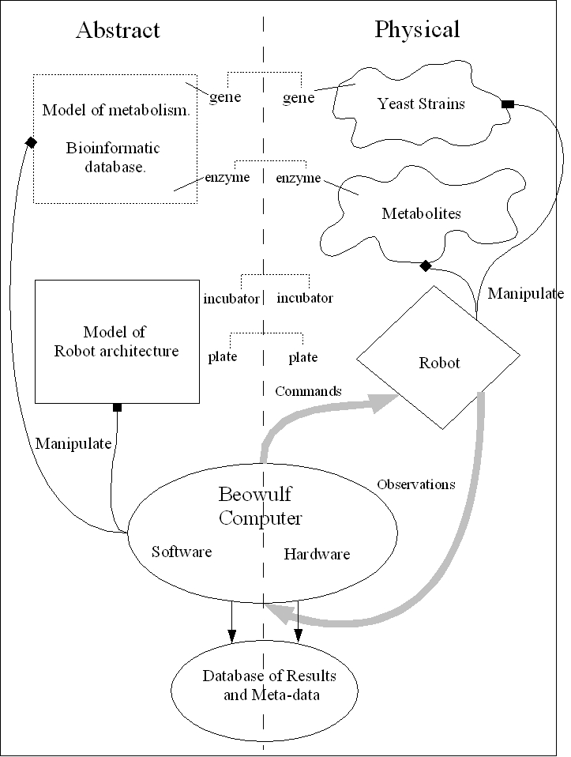
Overall View of the Universe

Slide 30
The Position of EXPO
SUMO
Upper level
Bibliographic Data Ontology
EXPO
Measurement ontology
BiblioReference
Mes.Unit
Generic level
SubjectOfExp.
ObjectOfExp.
Domain level
Domain Model
MO
PSI
Plant ontology
FuGO
MSI
ChEBI

Slide 31
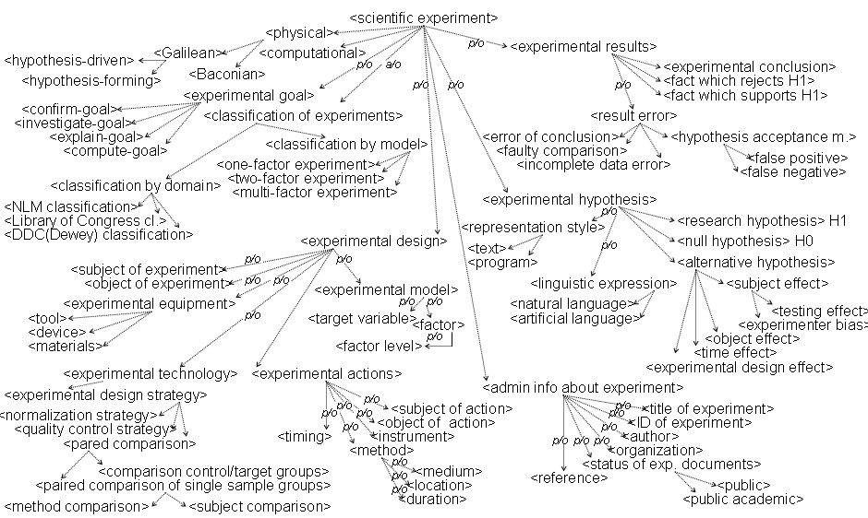
Small Section of EXPO

Slide 32
Adam’s Investigations
This formalisation involves >10,000 different research units in a nested tree-like structure 11 levels deep.
It logically connects >6.6 million OD600_{nm} measurements to hypotheses, experimental goals, results, etc.
No previous large-scale experimental work has been so comprehensively described and recorded.

Slide 33
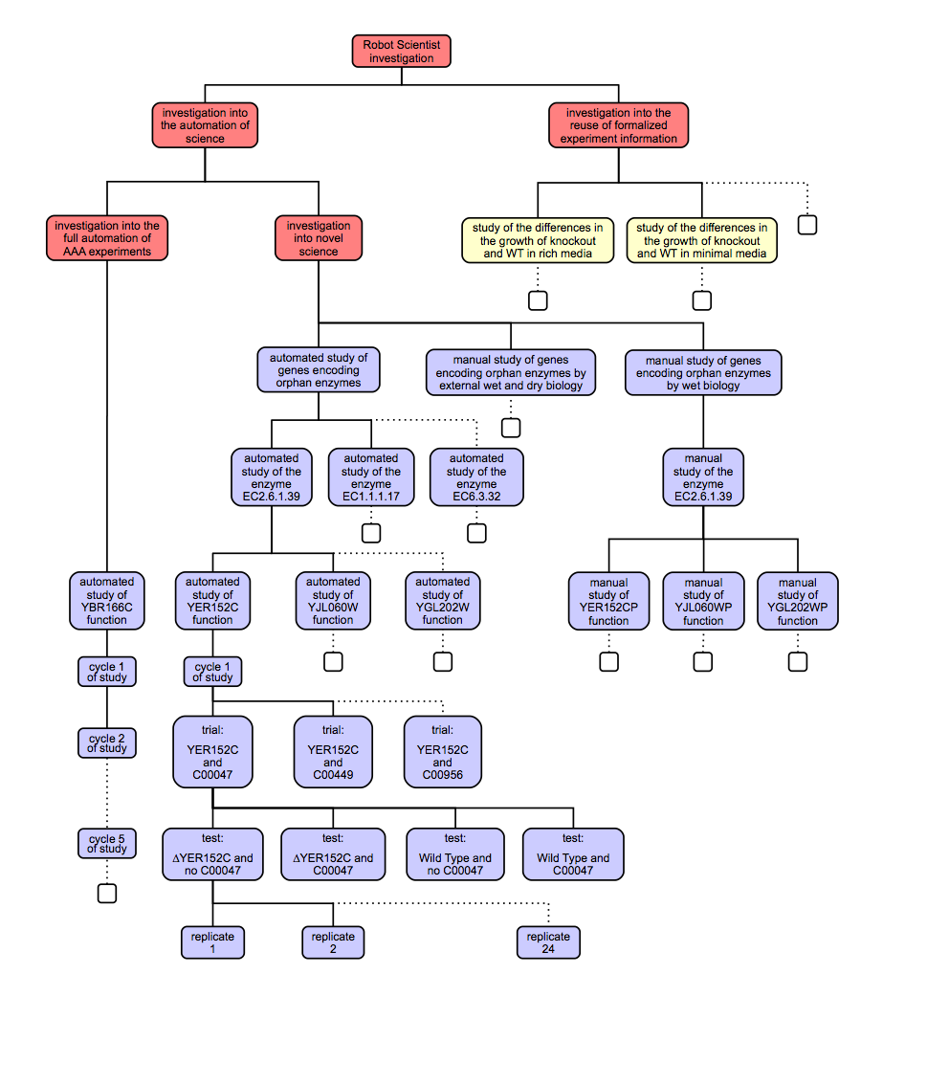

Slide 34
Levels in the Formalisation
Investigation into the automation of Science
Investigation into the automation of novel science
Investigation into the automated discovery of genes encoding orphan enzymes
Automated study of E.C.2.6.1.39 encoding
Cycle 1 of automated study of YER152C function
YER152C and Lysine automated trial
Experiment 1 (wild-type no metabolite)
Replicate 1 (well)
Observation 1

Slide 35
automated study of yer152c function
automated study: automated study of yer152c_function
has domain of study: functional genomics
has investigator = robot scientist Adam
has goal: 'To test the hypothesis that gene YER152C encodes an enzyme with enzyme class E.C.2.6.1.39'.
has organism of study: Saccharomyces Cerevisiae
has ncbi taxonomy ID: 4932
has hypotheses-set:
has research hypothesis 1: encodes(yer152c,ec_2_6_1_39)
has negative hypothesis 2: not encodes(yer152c,ec_2_6_1_39)
has cycle 1 of study
has study result: the strength of evidence that encodes(yer152c,ec_2_6_1_39):
highest accuracy of random forest evidence: 74%
proportion of random forest evidence >=70%: 2/3
has study conclusion: hypothesis 1 confirmed
has text representation:
a:automated study(X) :- a:automated_study_of_yer152c_function.
a:hypotheses-set(X) :- a:research_hypothesis(X).
a:cycle_of_study(X) :- a:cycle_1_of_study_(X).
a:hypotheses-set(X) :- a:negative_hypothesis(X).
a:domain_of_study(Y) :- a: automated study(X), a:has_ domain_of_study(X,Y).
a:investigator(Y) :- a: automated study(X), a:has_ investigator(X,Y).
a:goal(Y) :- a: automated study(X), a:has_goal(X,Y).
a:organism_of_study (Y) :- a: automated study(X), a:has_organism_of_study(X,Y).
a:hypotheses-set(Y) :- a: automated study(X), a:has_hypotheses-set(X,Y).
a:cycle_of_study(Y) :- a: automated study(X), a:has_cycle_of_study(X,Y).
a:study_result(Y) :- a: automated study(X), a:has_study_result(X,Y).
a:study_conclusion(Y) :- a: automated study(X), a:has_study_conclusion(X,Y).
a:domain_of_study(X) :- a:functional_genomics.
a: investigator(X) :- a:adam.
a:goal(X) :- a: to_test_the_hypothesis_that_gene_YER152C
_encodes_an_enzyme_with_enzyme_class_E_C_2_6_1_39.
a:organism_of_study(X) :- a:saccharomyces_cerevisiae.
a:study_result(X) :- a:the_strength_of_evidence_of_hyypothesis_1.
a:study_conclusion(X) :- a:hypothesis_1_confirmed.
has datalog representation:
<?xml version="1.0"?>
<rdf:RDF
xmlns="http://www.owl-ontologies.com/Ontology1204198571.owl#"
<owl:Class rdf:ID="goal"/>
<owl:Class rdf:ID="study_result"/>
<owl:Class rdf:ID="ncbi_taxonomy_ID"/>
<owl:Class rdf:ID="cycle_of_study"/>
<owl:Class rdf:ID="negative_hypothesis">
<rdfs:subClassOf>
<owl:Class rdf:ID="hypotheses-set"/>
</rdfs:subClassOf>
</owl:Class>
<owl:Class rdf:ID="domain_of_study"/>
<owl:Class rdf:ID="organism_of_study"/>
<owl:Class rdf:ID="cycle_1_of_study_">
<rdfs:subClassOf rdf:resource="#cycle_of_study"/>
</owl:Class>
<owl:Class rdf:ID="automated_study">
<rdfs:subClassOf>
<owl:Restriction>
<owl:someValuesFrom rdf:resource="#goal"/>
<owl:onProperty>
<owl:ObjectProperty rdf:ID="has_goal"/>
</owl:onProperty>
</owl:Restriction>
</rdfs:subClassOf>
<rdfs:subClassOf>
<owl:Restriction>
<owl:someValuesFrom rdf:resource="#organism_of_study"/>
<owl:onProperty>
<owl:ObjectProperty rdf:ID="has_organism_of_study"/>
……………………………………………………….
has OWL representation:

Slide 36
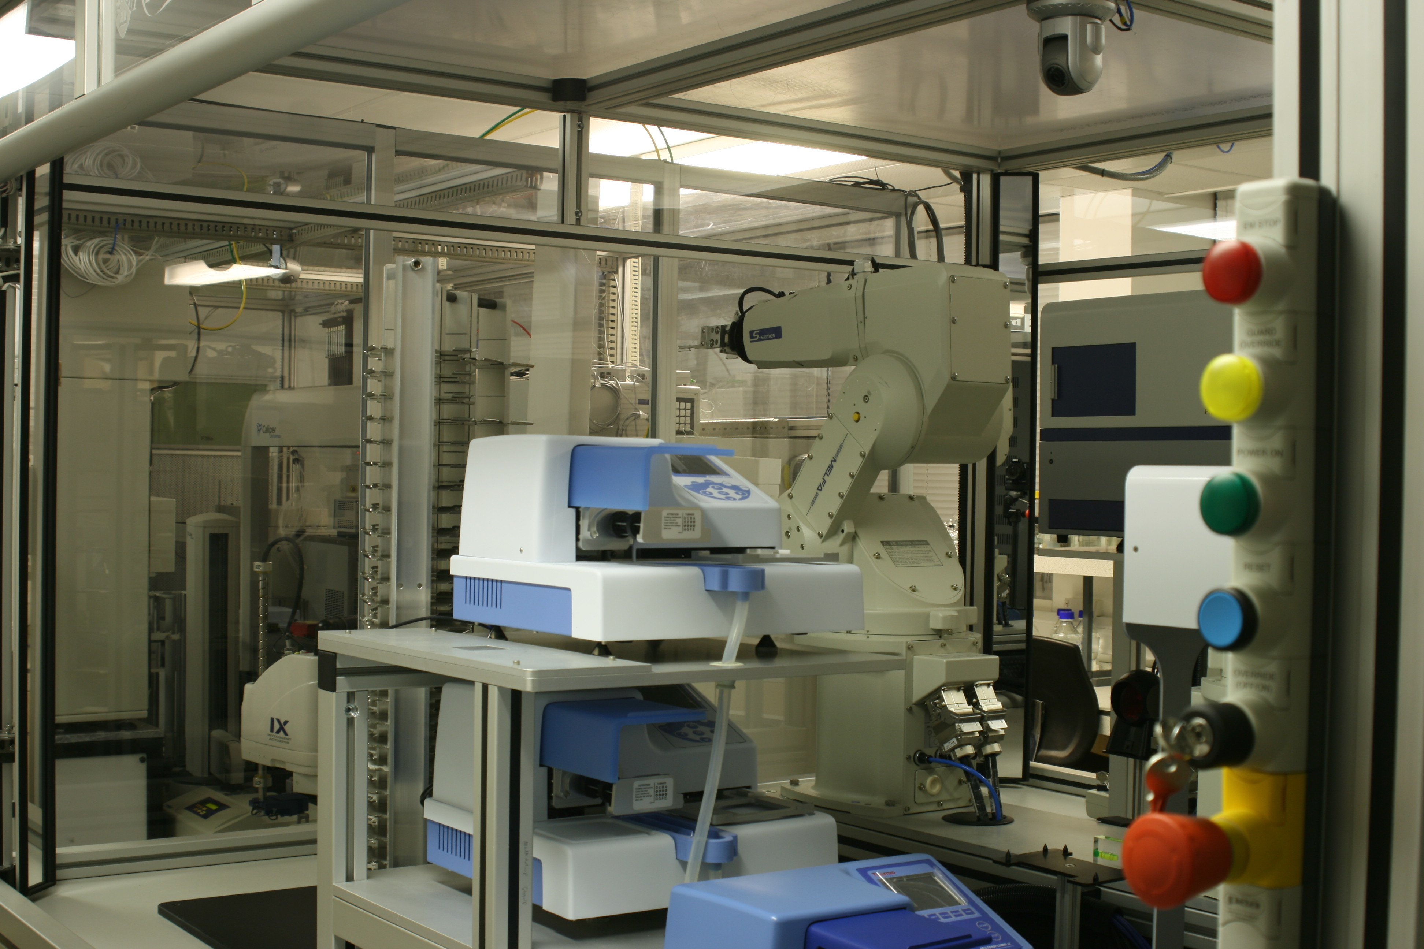
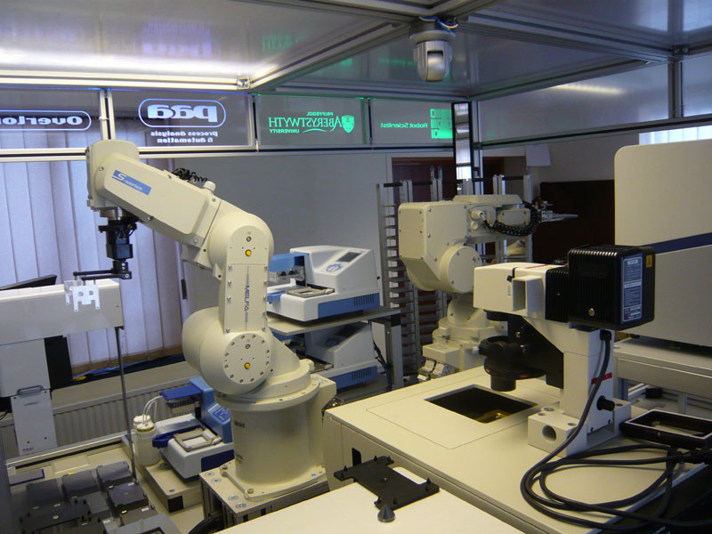
Eve
Drug Design

Slide 37
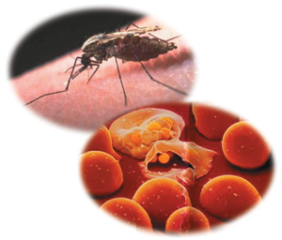
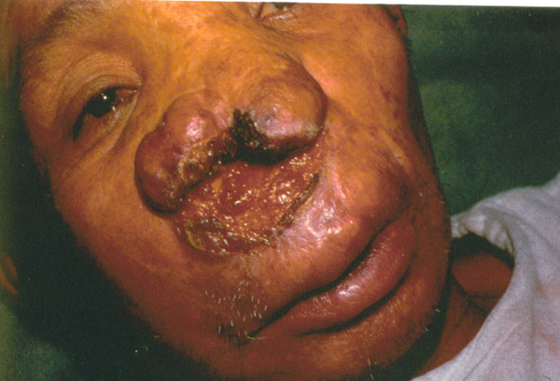
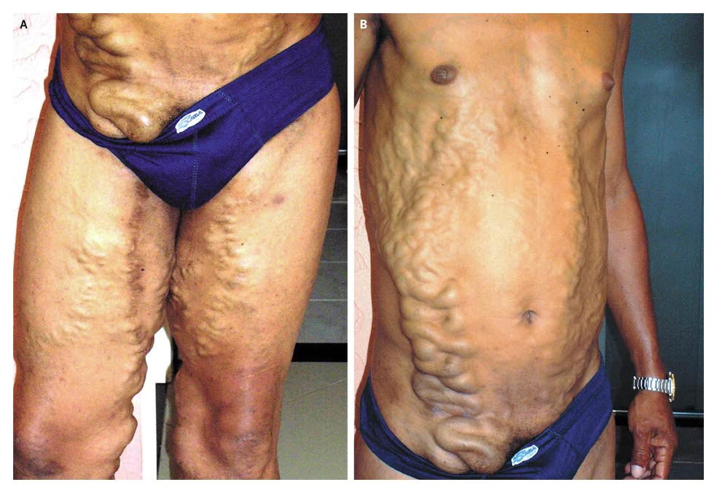
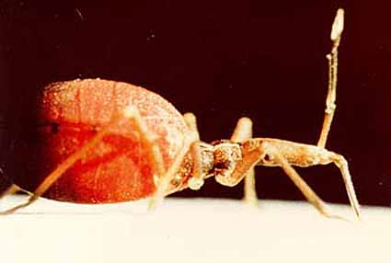
The Application Domain
Malaria
Shistosomaisis
Leishmania
Chagas

Slide 38
Why Tropical Diseases?
Millions of people die of these diseases, and hundreds of millions of people suffer infection.
It is clear how to cure these diseases – kill the parasites.
They are “neglected”, so avoid competition from the Pharmaceutical industry.

Slide 39
Formalising the Problem
Use graphs and standard chemoinformatic methods to represent background knowledge - the use of relations is planned.
Uses induction (quantitative structure activity relationship –QSAR learning) to infer new hypotheses.
Use active learning to decide efficient experiments, and econometric model to decide what compounds to test.

Slide 40
Eve’s Automation of Pipeline
Library screening
Standard library screening is brute force:
Eve uses intelligent screening
In the standard “pipeline” the 3 processes are not integrated.
In Eve automated and integrated.
Hits
Hit confirmation
Confirmed hits
Predicted hits
Learn QSAR/Intelligent screening
Lead
Offline validation

Slide 41
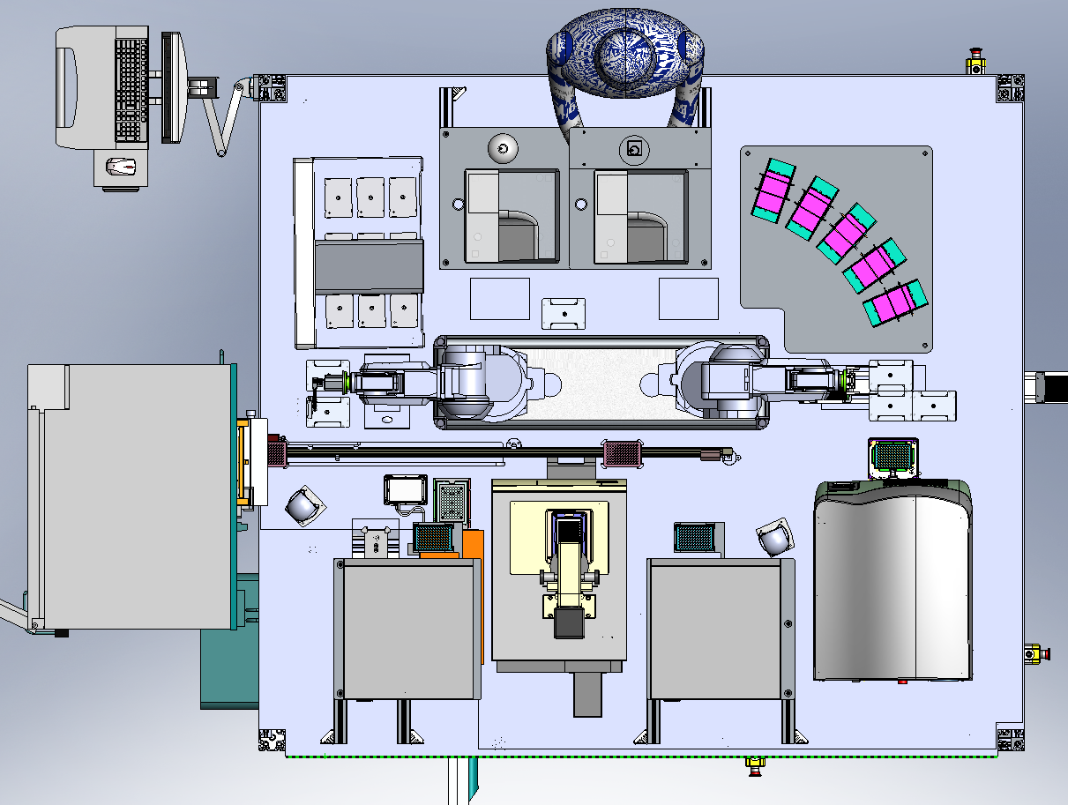
Eve’s Hardware
Highlights of Eve's hardware:
Acoustic liquid handling
High throughput 384 well plates
Two industrial robot arms
Automated 60x microscope
Liquid handlers, fluorescence readers, barcode scanners, dry store, incubator, tube decapper ...

Slide 42
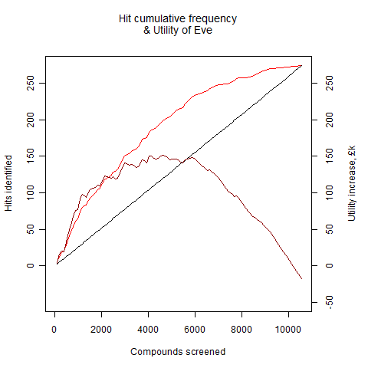
The Economics of Intelligent Screening
Nm - Number of compounds not assayed by Eve
Tm - Cost of the time to screen a compound using the mass screening assay
Cm - Cost of the loss of a compound in the mass screening assay
Nx - Number of hits missed by Eve
Tc - Cost of the time to screen a compound using a cherry-picking (confirmation or intelligent) assay
Cc - Cost of the loss of a compound in a cherry-picking assay
Uh - Utility of a hit
Ne - Number of compounds assayed by Eve

Slide 43
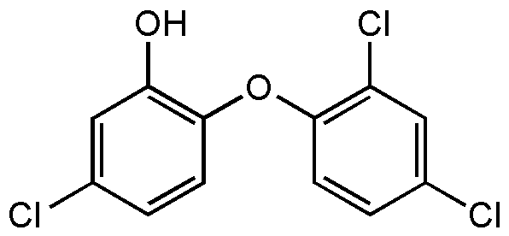
Triclosan Repositioned for Malaria
Simple compound
Known to be safe – used in toothpaste.
Targets both DHFR and FAS-II – well established targets.
Demonstrated activity using multiple wet experimental techniques.
Works against wild-type and drug-resistant Plasmodium falciparum, and Plasmodium vivax.

Slide 44
Future Prospects

Slide 45
The Future?
In Chess/Go there is a continuum of ability from novices up to Grandmasters.
I argue that this is also true in science, from the simple research of Eve, through what most human scientists can achieve, up to the ability of a Newton or Einstein.
If you accept this, then just as in Chess/Go, it is likely that advances in computer hardware and software will drive the development of ever smarter Robot Scientists.
In favour of this argument are the ongoing development of AI and laboratory robotics.

Slide 46
Vision
The collaboration between Human and Robot Scientists will produce better science than either can alone – human/computer teams still play better chess that either alone.
Scientific knowledge will be primarily expressed in logic with associated probabilities and published using the Semantic Web.
The improved productivity of science leads to societal benefits: better food security, better medicines, etc.
The Physics Nobel Frank Wilczek is on record as saying that in 100 years’ time the best physicist will be a machine.

Slide 47
Conclusions
Science is a wonderful application area for AI.
Automation is becoming increasingly important in scientific research e.g. DNA sequencing, drug design.
The Robot Scientist concept is the logical next step in scientific automation.
The Robot Scientist Adam was the first machine to have discovered novel scientific knowledge.
The Robot Scientist Eve has found new lead compounds for neglected tropical diseases.
The Robot Scientist Eve can accelerate systems biology modelling.

Slide 48
Acknowledgments
The Robot Scientist team: Manchester, Aberystwyth, Cambridge, Brunel, Leuven, Thailand. (BBSRC)
Chicago Big Mechanism consortium. (DARPA)
AdaLab consortium. (CHIST-ERA)
AIST (Tokyo)

